Slide 1
My Portfolio Website
Subtitle:
Professional Portfolio for Showcasing Skills, Projects, and Career Profile
Presented by :
Purna Chandra Rao Chimata

Slide 2
Introduction
The Personal Portfolio Website is a professional web application developed to present my educational background, technical skills, certifications, projects, and contact details in a structured manner. It serves as an online resume that allows recruiters and employers to learn about my qualifications and achievements through a single platform.
Professional online portfolio
Digital representation of resume
Showcases skills and projects
Easy access to professional profiles
Developed using HTML and CSS
Purna Chandra Rao Chimata | Personal Portfolio HTML Project Presentation

Slide 3
Project Objective
The objective of this project is to create a personal portfolio website that highlights my technical skills, academic achievements, certifications, and project experience while demonstrating my web development abilities.
Build professional online presence
Display technical skills
Showcase academic projects
Improve employability
Demonstrate web development knowledge

Slide 4
System Modules
The portfolio is divided into different sections to organize information effectively and improve user navigation.
Modules
Home Page
About Page
Skills Page
Projects Page
Contact Page

Slide 5
Technologies Used
Key Points
Front-End
HTML5
Development Tools
Visual Studio Code
GitHub
Web Browser
Design Components
Navigation Bar
Tables
Images
Progress Bars
Hyperlinks

Slide 6
HTML Tags Used - Elements & Tables
Layout Tags Content Tags
<html> <h1> to <h6>
<head> <p>
<body> <img>
<div> <a>
<nav> <table>
<section> <tr>
<footer> <th>
<td>
<progress>

Slide 7
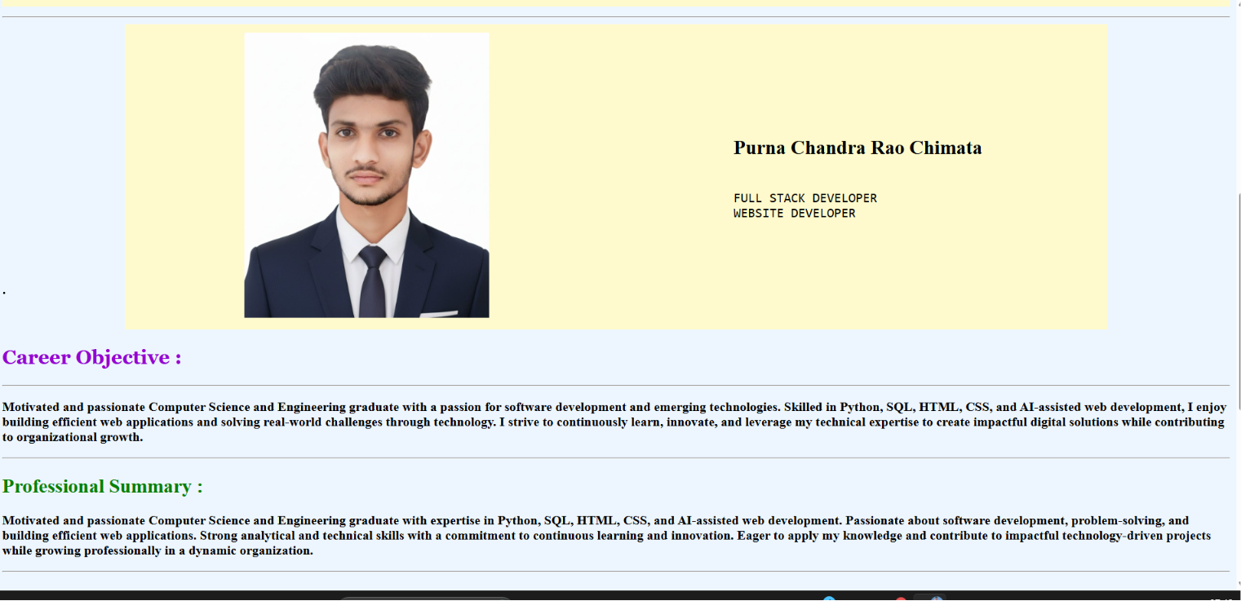
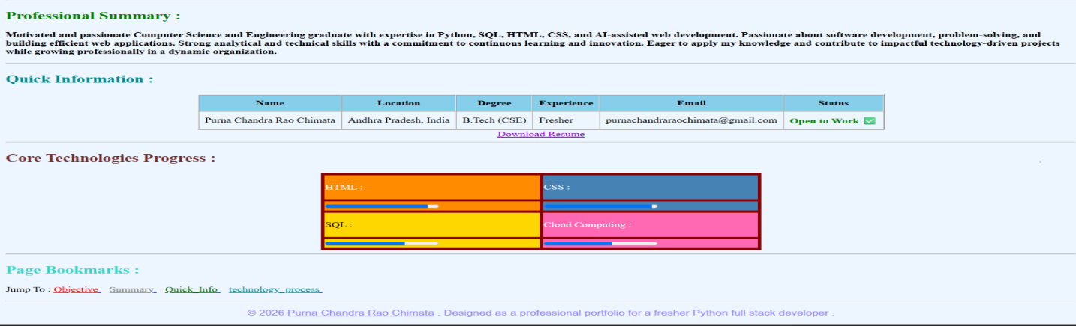
Home Page
The Home Page acts as the landing page of the portfolio and provides a brief introduction along with navigation links and professional information.
Features
Professional banner
Profile information
Career objective
Professional summary
Quick information table
Resume download option

Slide 8
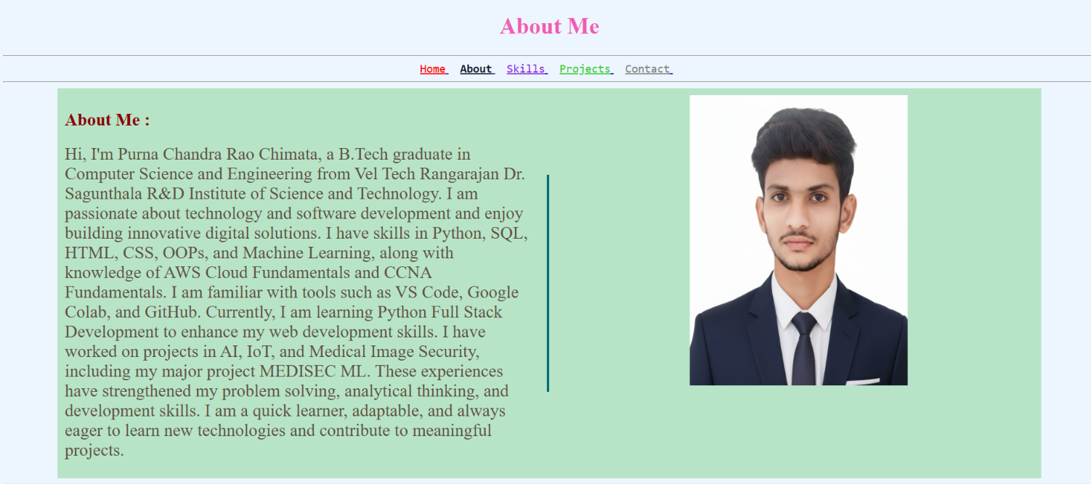
About Page
The About Page provides detailed information regarding education, technical knowledge, certifications, and career goals.
Features
Educational background
Technical skills overview
Certifications
Career aspirations
Personal profile

Slide 9
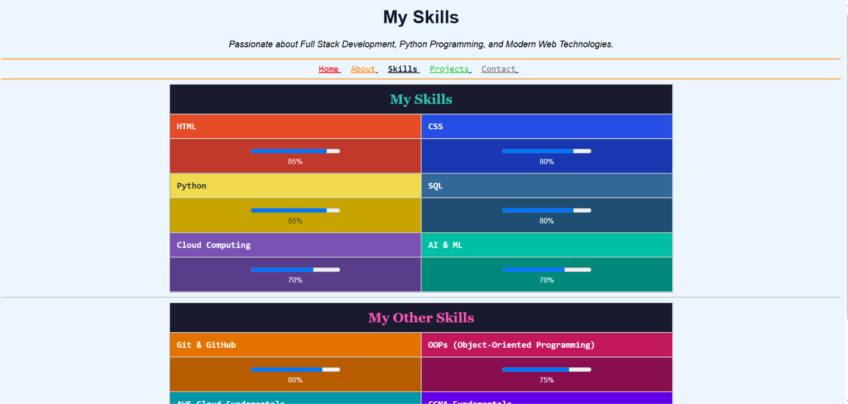
Skills Page
The Skills Page visually represents technical competencies using progress indicators and categorized skill sections.
Technical Skills
HTML – 85%
CSS – 80%
Python – 85%
SQL – 80%
Cloud Computing – 70%
AI & ML – 70%

Slide 10
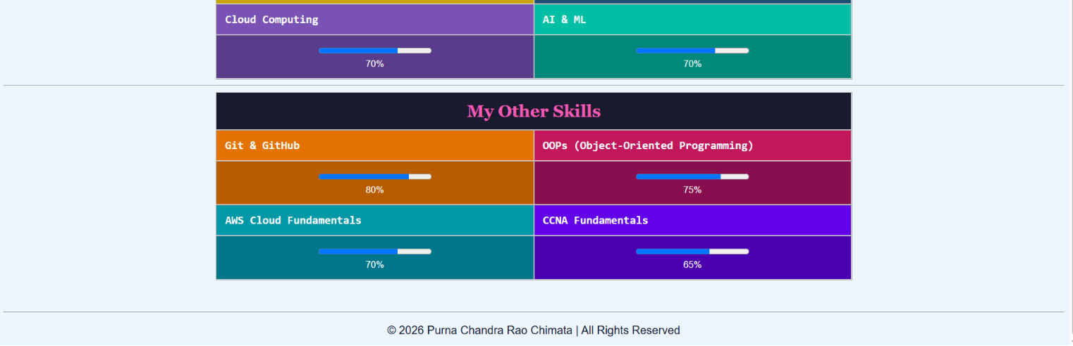
Additional Skills
Git & GitHub – 80%
OOPs – 75%
AWS Fundamentals – 70%
CCNA Fundamentals – 65%

Slide 11
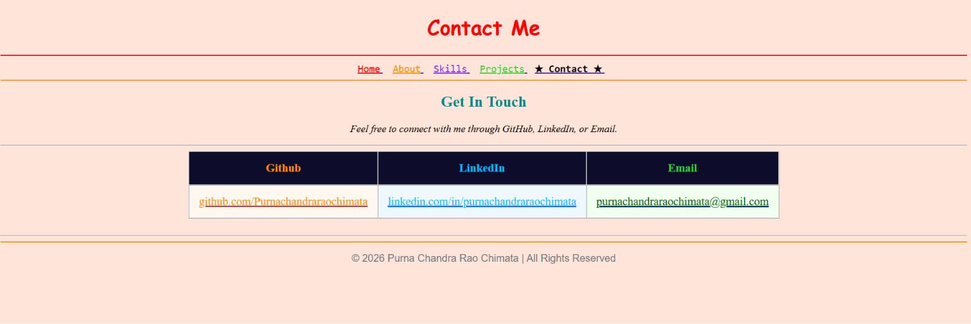
Contact Page
The Contact Page allows visitors and recruiters to connect through professional platforms and email.
Contact Methods
GitHub
LinkedIn
Email

Slide 12
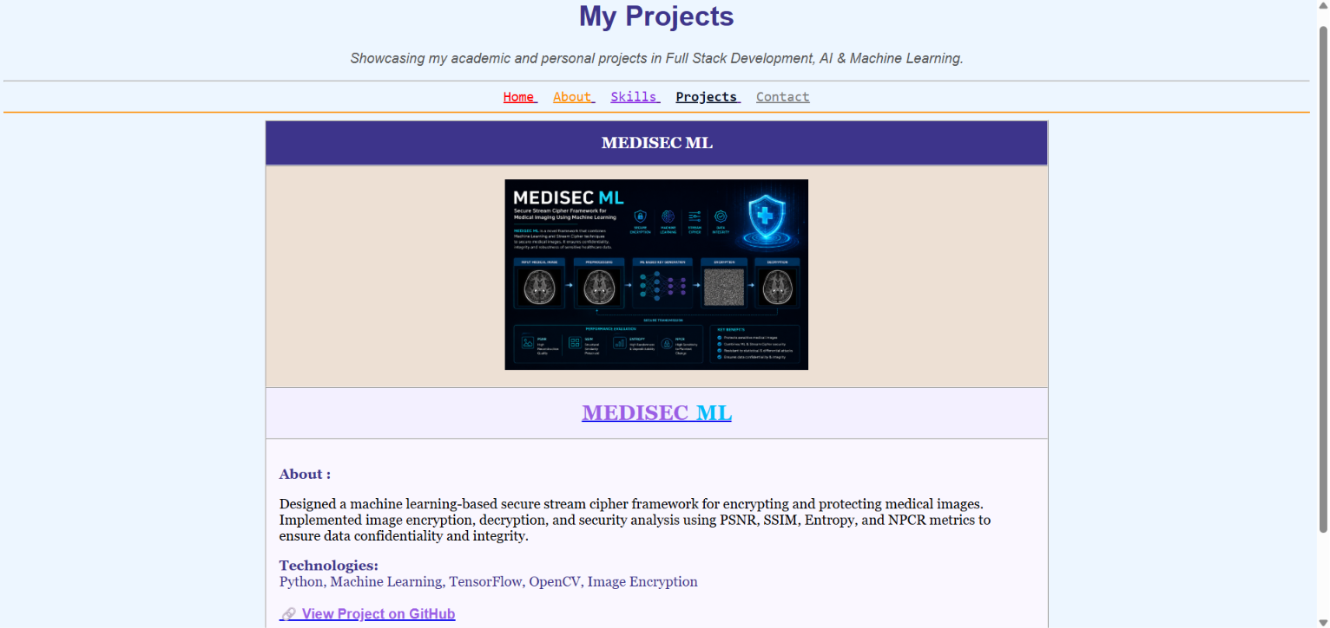
Projects Page
The Projects Page highlights the major academic project completed during B.Tech and provides project details along with technologies used.
Project
MEDISEC ML
Medical image security framework
Image encryption and decryption
Machine Learning integration
Security analysis using PSNR,
SSIM, Entropy, and NPCR
Technologies
Python
TensorFlow
OpenCV
Machine Learning

Slide 13
Key Features
Points
Professional user interface
Multi-page navigation
Responsive design
Skill visualization
Project showcase section
Social media integration
Resume accessibility
Organized content structure

Slide 14
Challenges Faced
Points
Designing page layouts
Aligning images and content
Creating responsive sections
Managing navigation links
Styling tables and progress bars
Maintaining consistent design
Paragraph
During development, several design and layout challenges were encountered, particularly in content alignment and maintaining consistency across all pages. These challenges were resolved through testing and CSS customization.

Slide 15
Learning Outcomes
Points
Improved HTML and CSS knowledge
Learned website structuring
Enhanced UI design skills
Gained experience in multi-page development
Improved debugging skills
Better understanding of portfolio design
Paragraph
This project provided practical experience in front-end development and improved my ability to design professional websites while strengthening problem-solving and web design skills.

Slide 16
Conclusion
Paragraph
The Personal Portfolio Website was successfully developed to showcase my professional profile, technical skills, and project achievements. The project helped me strengthen my front-end development skills and create a professional platform that can be used for internships and job opportunities.
Key Points
Successfully completed portfolio website
Demonstrated web development skills
Created professional online presence
Showcased projects and achievements
Improved practical development experience

